Slide 1
Small Task Prototype System V1
Quick Prototype System

Slide 2
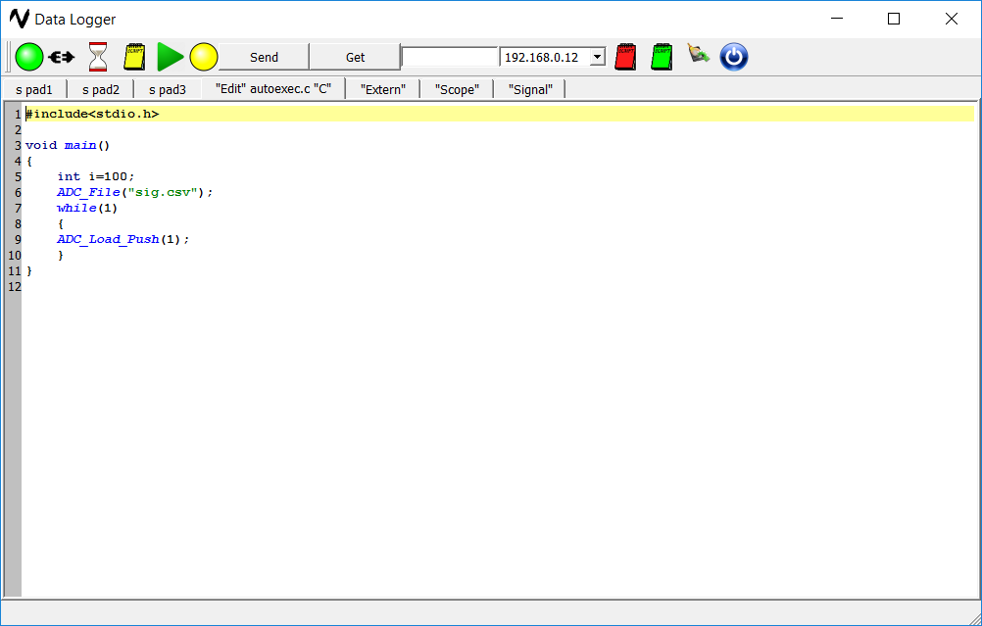
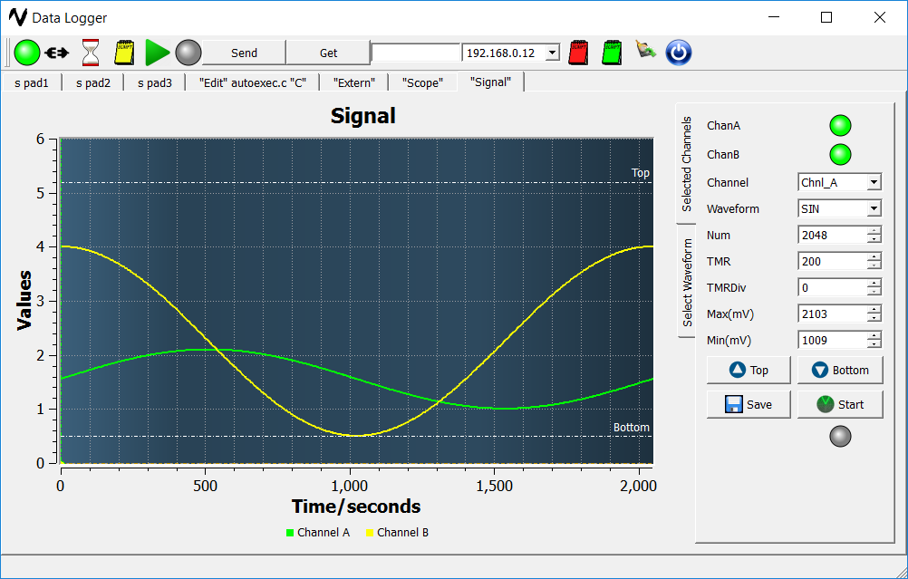
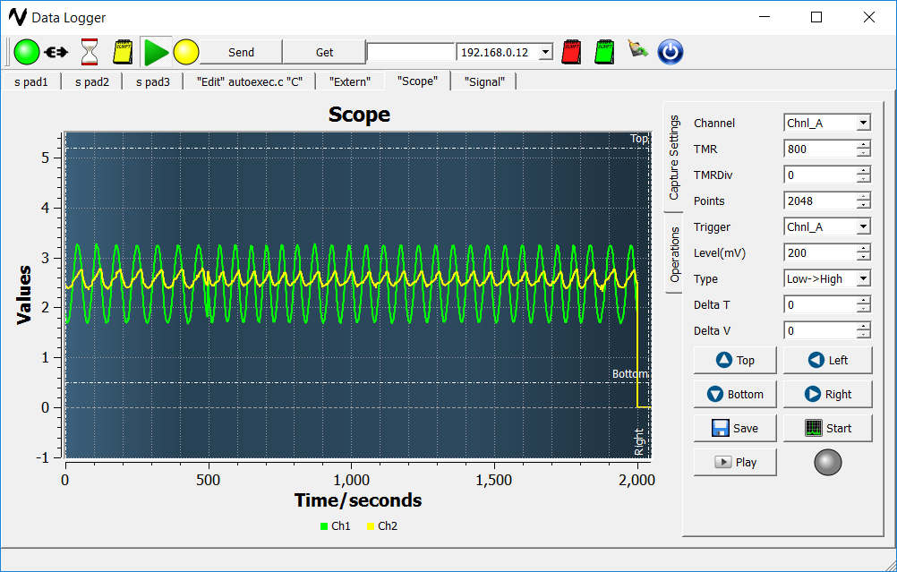
Open source GUI https://github.com/vijayandra/logger_v1
Modify according to users own need, we anticipate to start and support for open source Android/MAC application. We encourage user to write own application. You will need Qt and CoAP framework.

Slide 3
Concept
Device runs user defined “C” code without compiling. This saves time of learning device specific compiler/debugger/Libraries. STPS system has onboard SD card for saving device specific data.
For example: “autoexec.c” file in SD Card(FAT32) will cause LED to be ON for second and then turned OFF.
#include<stdio.h>
void main()
{
led_on(1);
ms_wait(100);
led_off(1);
Return 0;
}

Slide 4
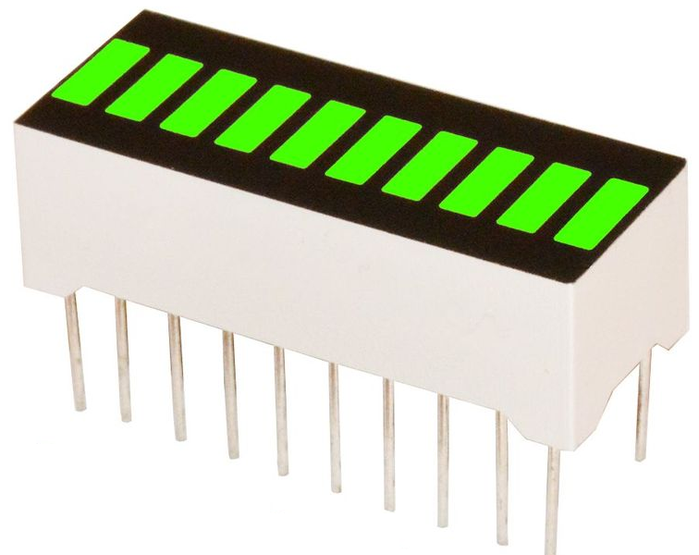
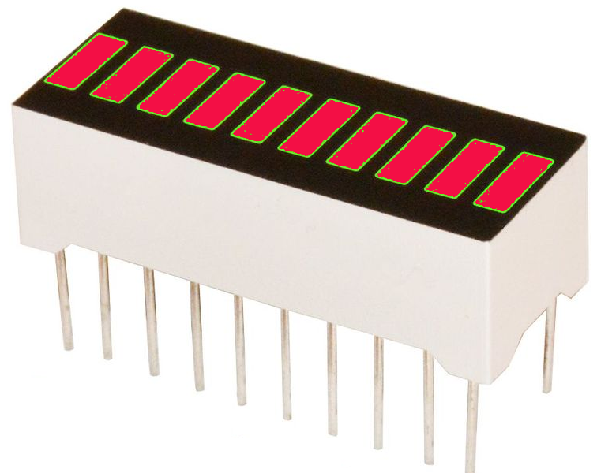
How much time it will take to run first “C” script
May take less then 5 mins, open box connect to ethernet ( Where device can get IP address via DHCP). Start application on any of local network computer Windows PC/Linux PC/or Raspberry PI. Start running supplied “C” scripts.
There are 10 onboard LED with 1 audible buzzer. Which user can interact with “C” during learning flow and later stage LED/Buzzer can be used for feedback.
#include<stdio.h>
void main()
{ led_on(1);
buzzer_beep(100);
ms_wait(100);
led_off(1);
Return 0;
}

Slide 5
How Application can locate my Device on same network
Device starts broadcasting one packet every 5 seconds interval with its IP address as soon as DHCP allocates IP address. PC application listens to this port for packets and connects to device so user can run script.
User control
Interface
DEVICE
RJ45 Ethernet

Slide 6
Available Resources on Device
1 Ethernet 10/100 Port
2 TTL UART (max 5.65MBPS)
1 RS485 Port with (max 15MBPS) (LTC2855CGN)
1 I2C
10 LED (Intended for active visual feedback)
1 Buzzer (3 KHz audible feedback )
1 SD Card slot (FAT32 )
1 Temperature/Humidity Sensor (SI7020)
2 ADC Port Input (Dual 12 bit 3.3V)
2 DAC Port Ouput (Dual 12 bit 3.3V)

Slide 7
Protocol is been used for communication
CoAP protocol encapsulated in RP (header below)is been used for communication, bottom layer of protocol is not part of CoAP standard.Every time when following frame transmitted receiver puts header (8 bytes in black) back to sender, sender marks frame received.
0x55H
0x55H
Len H
Len L
CRC H
CRC L
MID H
MID L
CoAP

Slide 8
Autoexec.c/Autoexe.ini
System starts executing autoexec.c file loaded from FAT32 SD Card.
For example following script turns LED off and LED on, at the end it issues audible buzzer
#include<stdio.h>
void main()
{ int i,j;
for(j=1; j<=9; j++)
{
led_on(j);
ms_sleep(20);
led_on(j);
}
buzzer_on(300);
Return 0;
}

Slide 9
Possible/Intended Use cases.
System can accept memory card upto 32G SD card.
Remote/autonomous data logging for UART/RS485/Analog/Digital
Home Temperature/Humidity logging directly into SDIO card.
Quick turnaround rapid prototype development system.
Teaching assistance with “C”programming hardware
Close loop automated testing platform.

Slide 10
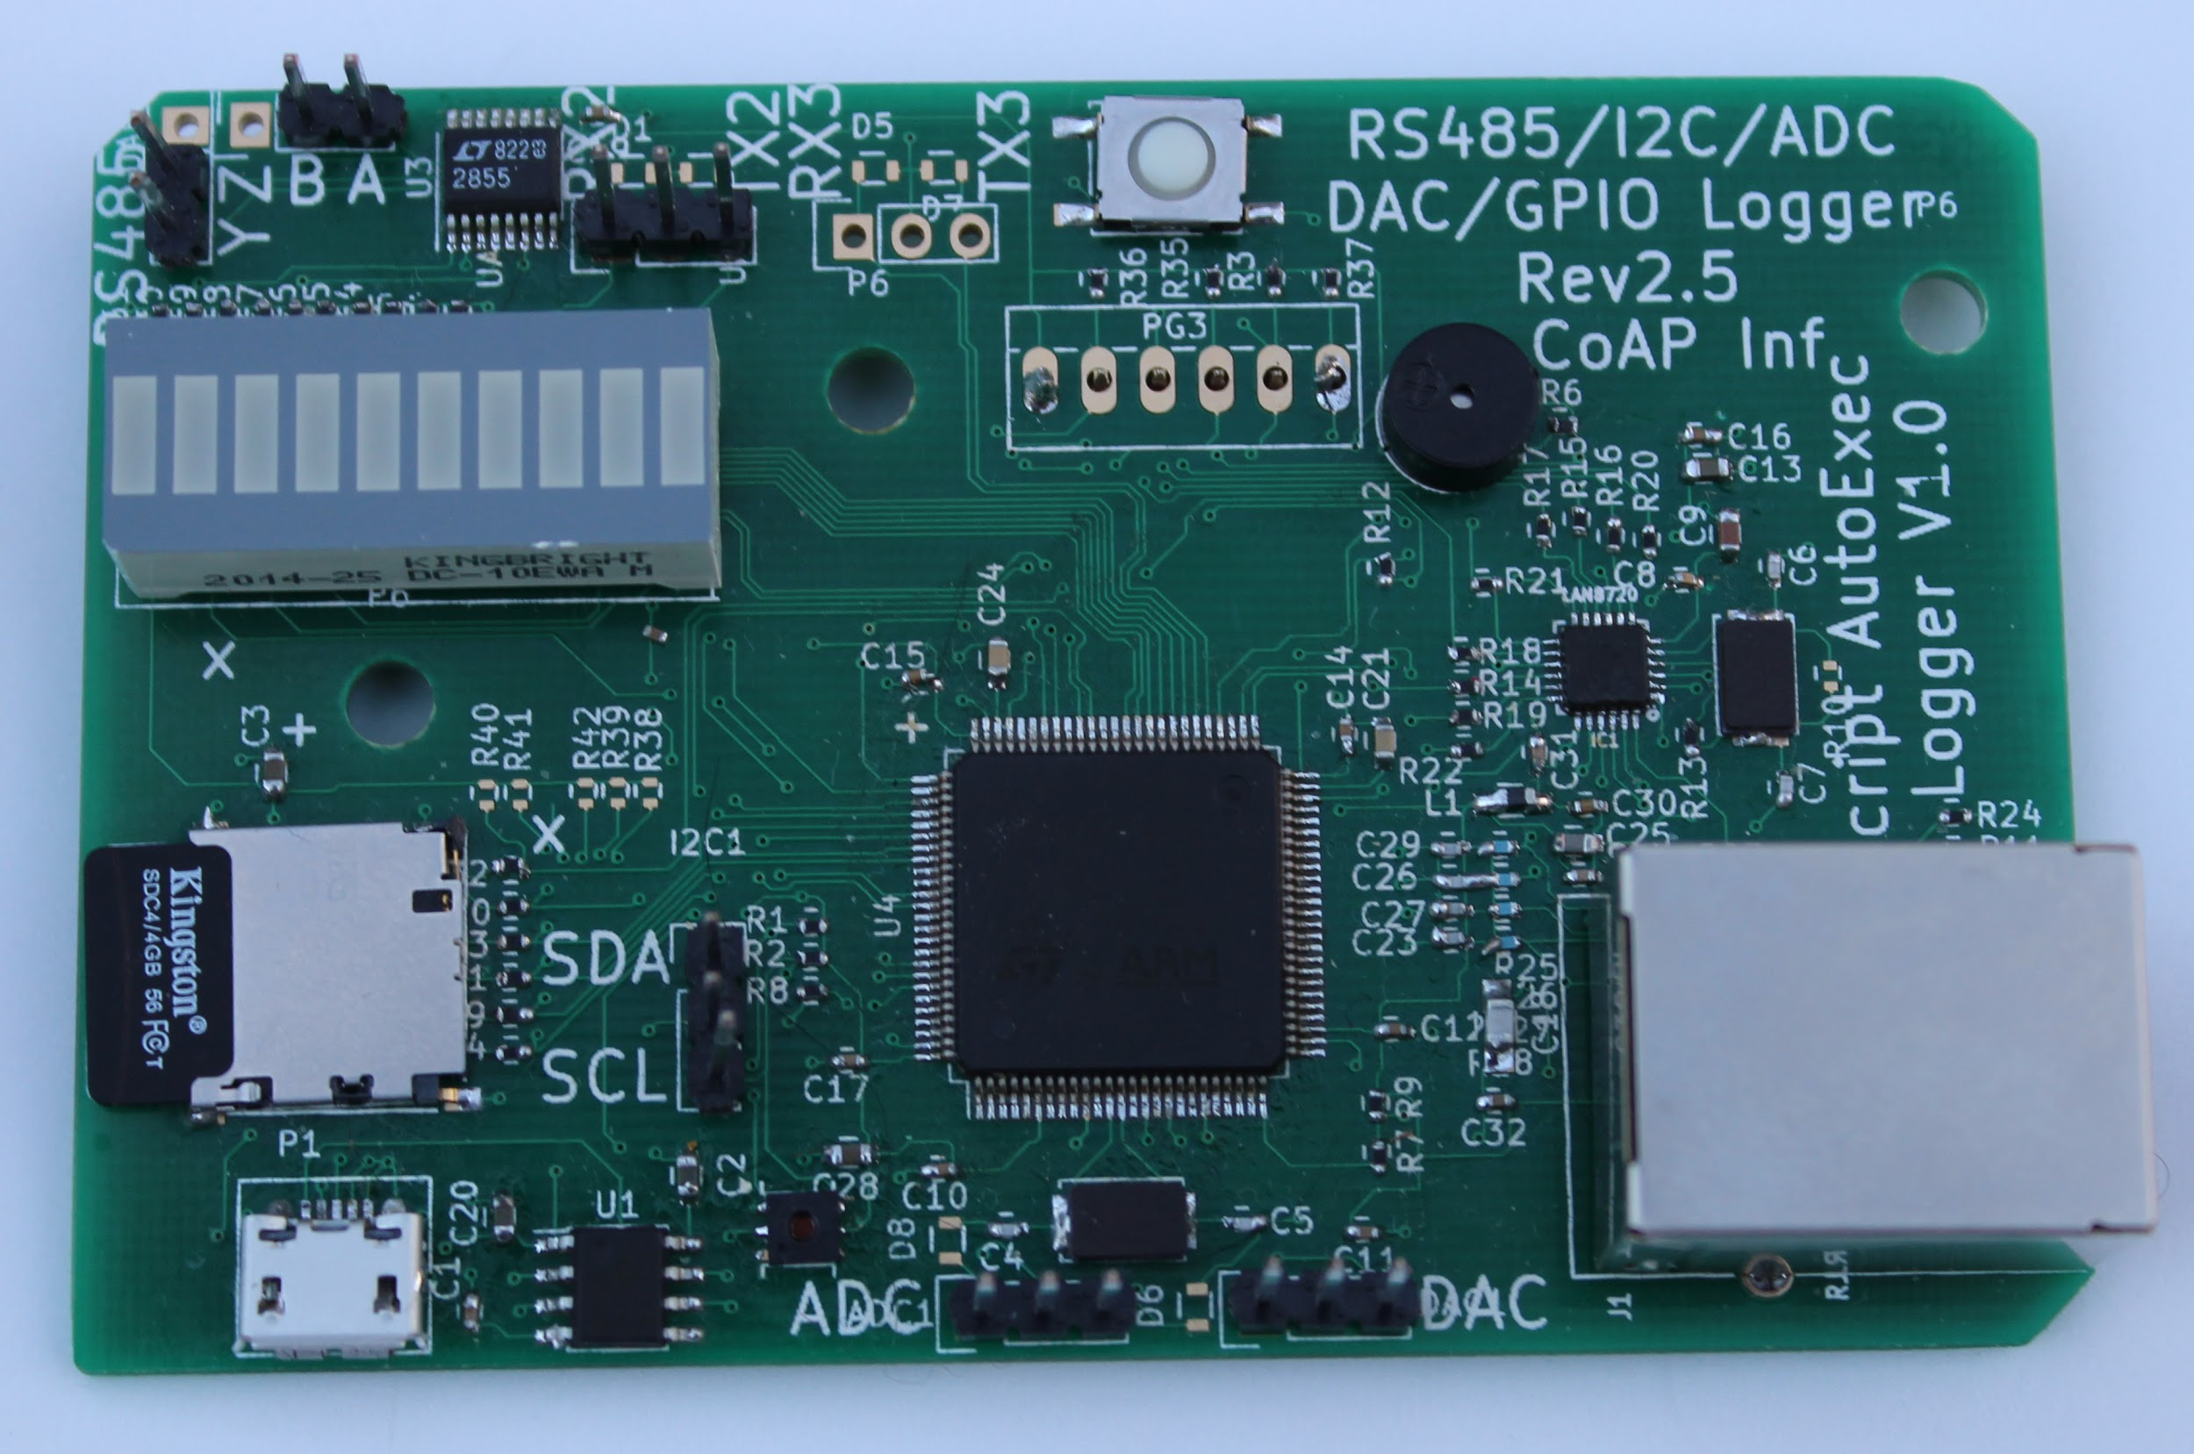
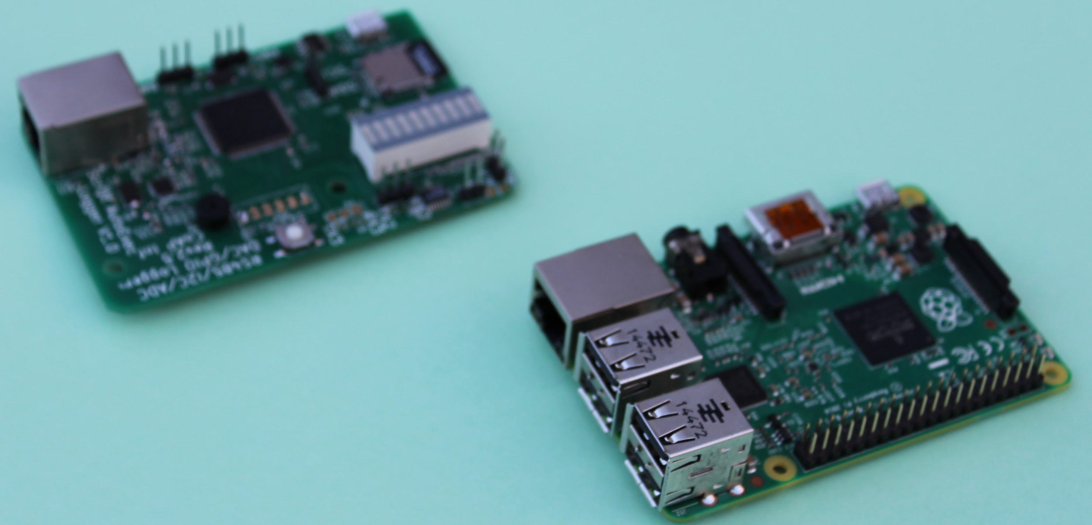
Reuse Raspberry PI2 Enclosure
Credit card size board just like raspberry PI, it may be accommodated in raspberry PI enclosure.
Similar size as Raspberry PI 2/3

Slide 11
Connector
Credit card size board just like raspberry PI, it may be accommodated in raspberry PI enclosure. (Middle PIN Ground)
UART2 RX
UART2 RX
UART3 RX
UART3 RX
RS485 TX+
RS485 RX+
Reset button
RS485 RX-
RS485 TX-
Audio buzzer
10/100 Ethernet
LED
I2C SDA
I2C SCL
SD Card
Micro USB just for power supply
I2C Humidity Temperature sensor
ADC Ch1
ADC Ch1
DAC Ch1
DAC Ch2

Slide 12
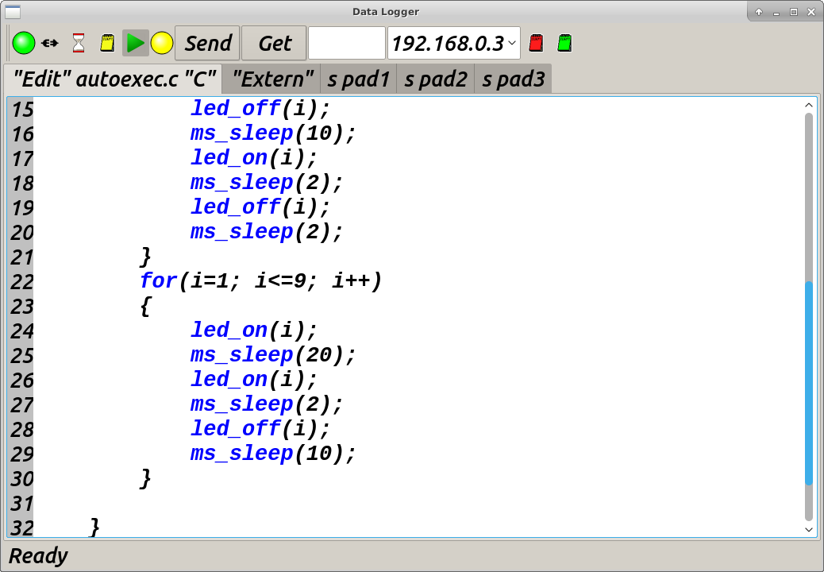
First look into GUI
This utility can download “C” script code into remote IP device with single mouse click. For example program below turns LED on and off.

Slide 13
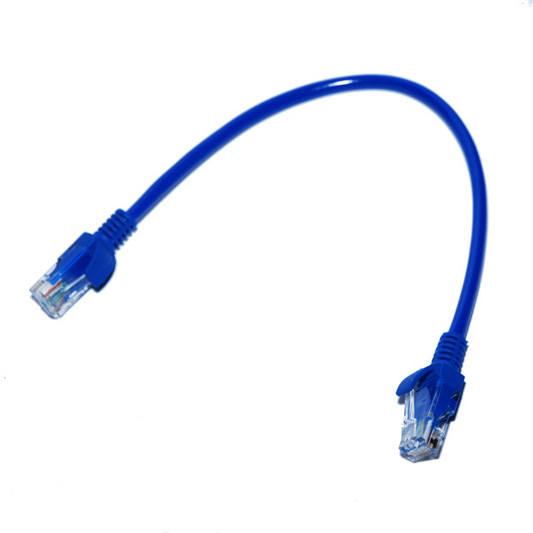

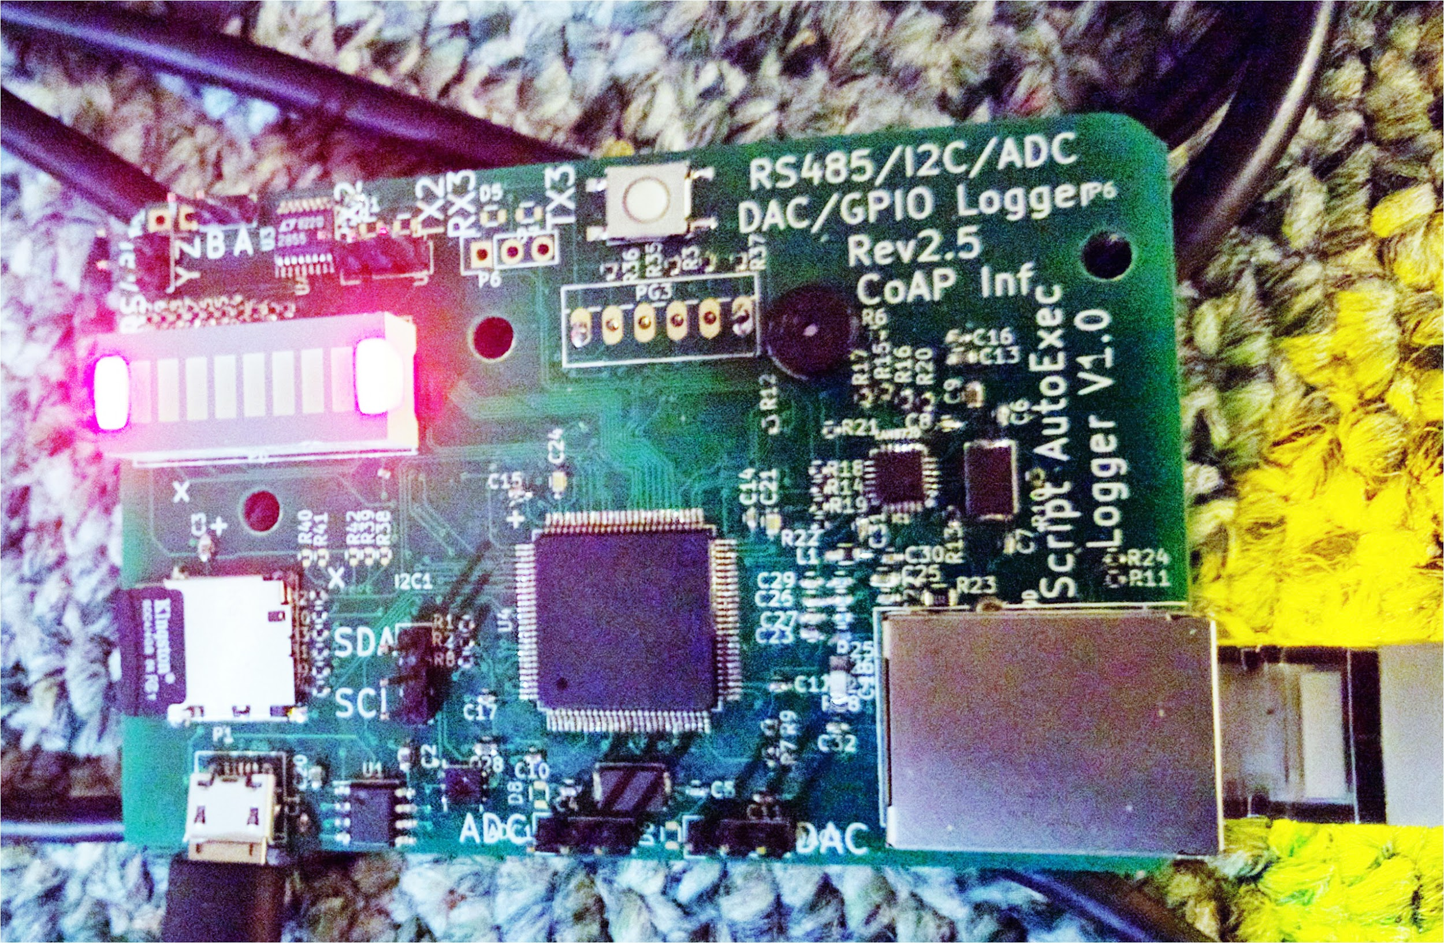
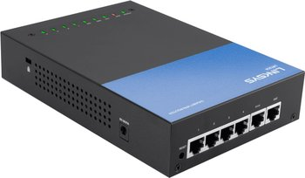

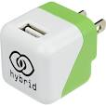
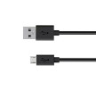
DIRECT Push script mode
User Edit and push “C” script into RAM via CoAP interface.
Std user debug printf from “C” script are transported via fast UDP pipe to PC
TTL UART/RS485
Dual 12 bit DAC/ADC for signal capture and signal generator
“C” Script
#include<stdio.h>
Ethernet 10/100 UDP ink

Slide 14
Autonomous Mode
System checks if “AUTORUN=1” in file autoexec.ini stored in SD Card, “C” script “autoexec.c” starts running as soon as device turns on.
All captured data being saved/Used to/from into SD Card.Active feed back can be part of autoexec.c script.
“C” Script
#include<stdio.h>
Ethernet 10/100 UDP ink
Optional

Slide 15
Prerequisites
Ethernet cable RJ45.
Micro USB power connector (Typical Android phone charger will work)
DHCP server where device can get iP address.
Network connected Linux/Windows computer with same DHCP server.
Few connection cable (some small cables are supplied)
Open box and connect to USB cable, one LED should turn On as soon as power is applied. Connect ethernet cable to router and hardware. Start Linux/Windows computer and launch following GUI application. Device broadcasts its IP address once every 5 seconds. PC application captures broadcast packet and autoconnect.

Slide 16
How to I run first autonomous mode data logger
Set “AUTORUN=1” in autoexec.ini in root of SD Card.
Create autoexec.c file, it will be blinking LED after power ON
#include<stdio.h>
void main()
{
while(1)
{
led_on(1);
ms_wait(100);
led_off(1);
}
ms_wait(100);
Return 0;
}
AUTORUN=1
NAME=pixie
autoexec.ini
autoexec.c

Slide 17
Hello LED (Autonomous mode)
AUTORUN=1
NAME=pixie
autoexec.ini
#include<stdio.h>
void main()
{
while(1)
{
led_on(1);
ms_wait(100);
led_off(1);
ms_wait(100);
}
ms_wait(100);
Return 0;
}
autoexec.c
This script will cause first led to be on for 100 millisecond and off for 100 millisecond.

Slide 18
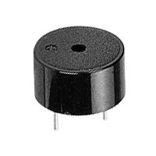
Hello BUZZER (Autonomous mode)
AUTORUN=1
NAME=pixie
autoexec.ini
#include<stdio.h>
void main()
{
led_on(1);
ms_wait(100);
led_off(1);
ms_wait(100);
beep_ms(1000);
Return 0;
}
autoexec.c
This script will cause first led to be on for 100 millisecond and off for 100 millisecond, followed by a beep sound.

Slide 19
Non Intrusive UART Bidirectional Sniffing/Logging
Single Richtextbox Ouput color (UART2 Red Rx,UART3 Green Rx)
0x19 0x12 0xac 0x31 0xb2 0x9c
(HEX)
Ethernet Link
SMALL Task Computer Device
UART2 Rx UART3 Rx
THIS IS TESTFROM UART2 RX 0UART3 RX CONTENT
(ASCII Tex)
User Device A
User Device B
UART RX
UART TX

Slide 20
Flexible Analog Logging
Single Richtextbox Ouput color (Analog 1MHZ Sampling, 12 Bit)
1.0f 1.1f 0.123f 1.30f
Ethernet Link
SMALL Task Computer Device
Analog Ch1 Analog Ch2
User Device A
User Device B
Analog (Upto 3.3V )
Analog (Upto 3.3V)

Slide 21
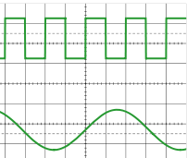
Analog Signal Generator
CSV Text File
Ch1,Ch2
-------------
1.23,1.1
1.20,1.2
3.10,2.2
Onboard SDIO Card(FAT32)
10.5 Mega samples per second
Direct play of signal from SDIO Card to DAC
SMALL Task Computer Device
DAC Ch1 DAC Ch2
Autonomous Start/User Trigger
User Device
Analog (Upto 3.3V )
Analog (Upto 3.3V)

Slide 22
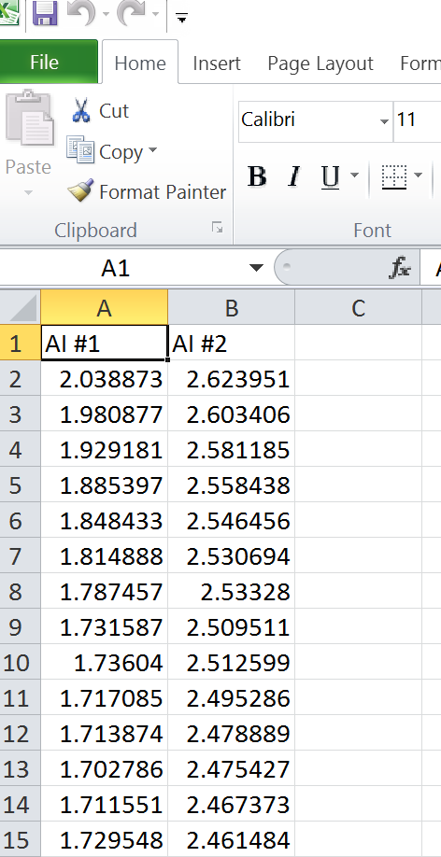
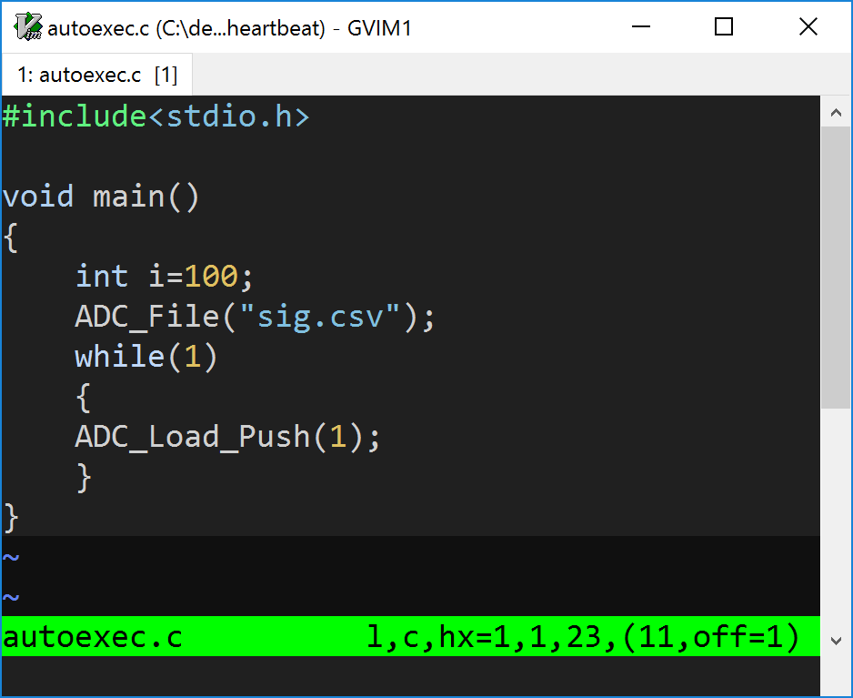
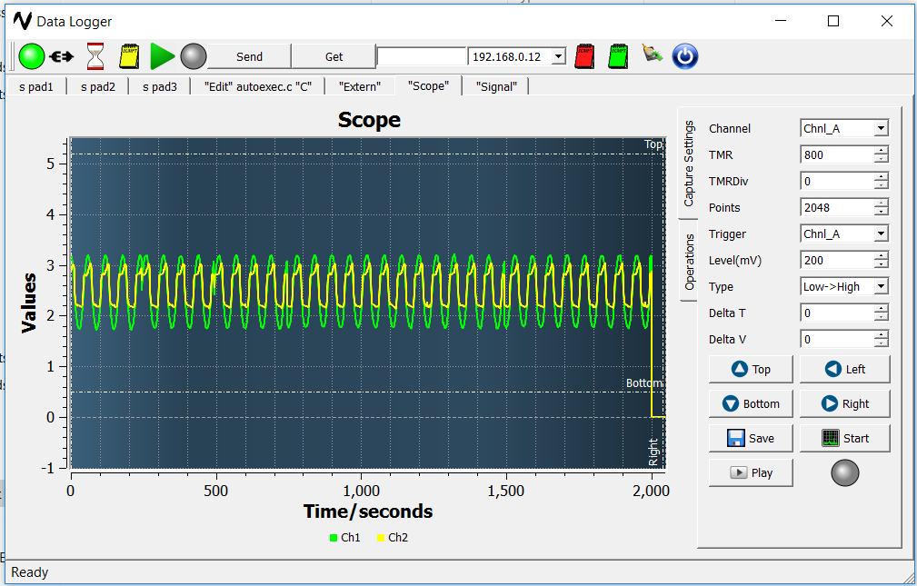
Sample “C” Script diff purpose (Generating signal,CSV)
Step 1. Save signal file CSV into root of SDCARD (FAT32).
Step 2. Put following autoexec.c file in SD card,
alongwith sig.csv (SD card size and FAT32 size is max limit)

Slide 23
Important Note
Please note that system is able parse “C” script, but error in “C” syntax can cause script decoder to crash. Please run so PC based error check utility before downloading it in hardware.
Small syntax error can cause loss of time spent in debugging so please use tools to check error.
Maximum size of script can be 6 KByte, as all complex functions are encapsulated in ROM so it plenty for any purpose.
Next Release will have on board SDRAM, which will enable end user with unlimited size of “C” script.

Slide 24
Permanent deployment for purpose of logging
1.Non stop logging of 2UART and 1RS485 Data into SD Card.
2.Humidity / Temperature logging into CSV file .
3.Dual Channel ADC 12bit logging to CSV file.
4.Direct dual analog signal generation based off CSV file stored in SD Card.
5.I2C Master signal.
6. Completely open source cross platform QT application.

